Slide 1
PA Week 9

Slide 2
Overview
Optimized Fitting
Parameters values
Outliers
Parameters and pressure correlation

Slide 3
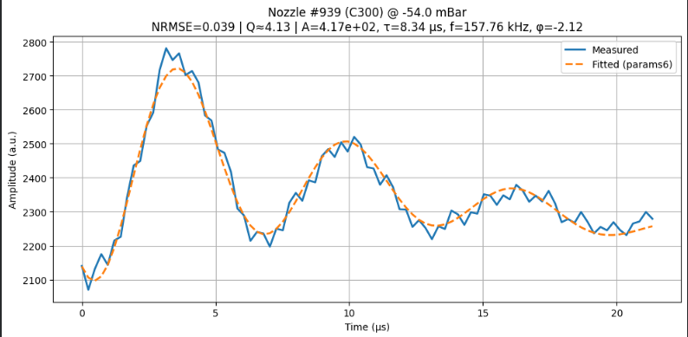
1. Optimized fitting

Slide 4
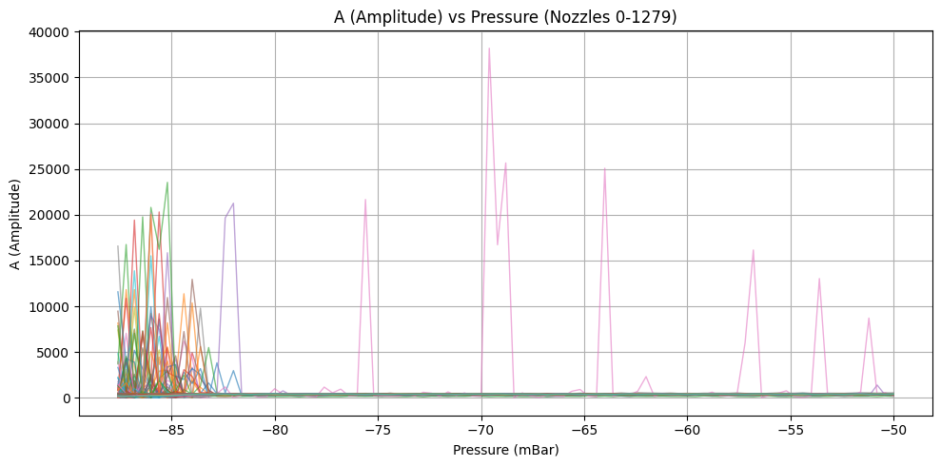
2. Parameters values

Slide 5
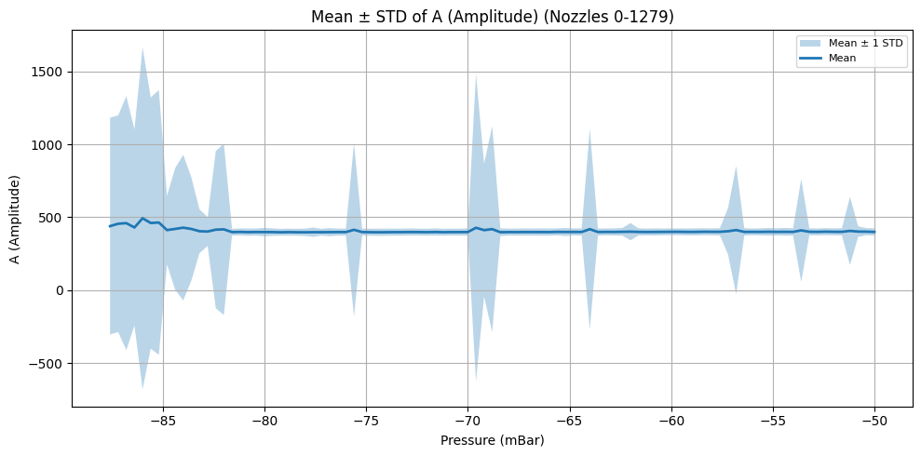

Slide 6
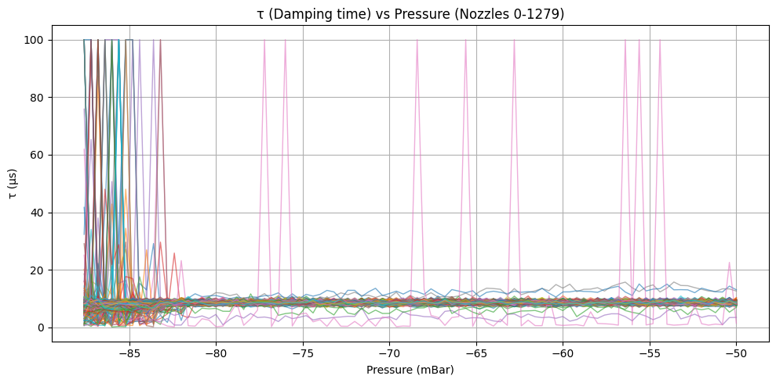

Slide 7
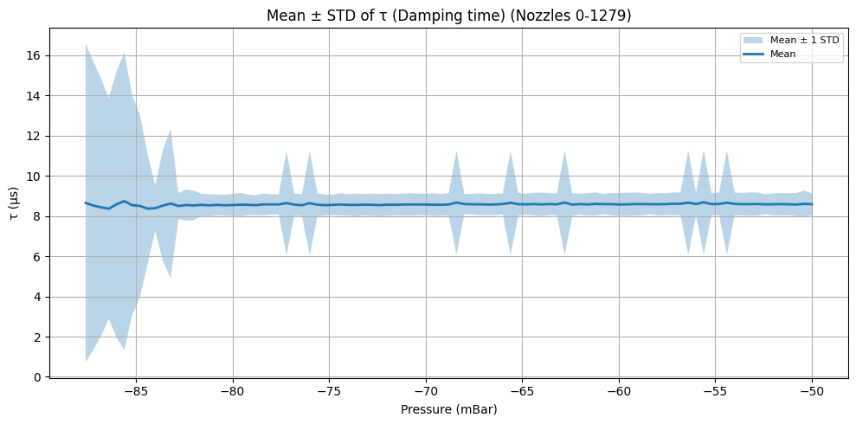

Slide 8
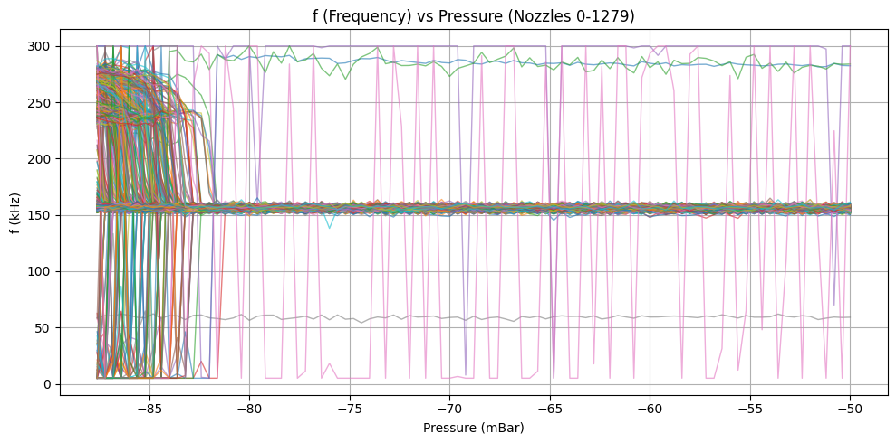

Slide 9
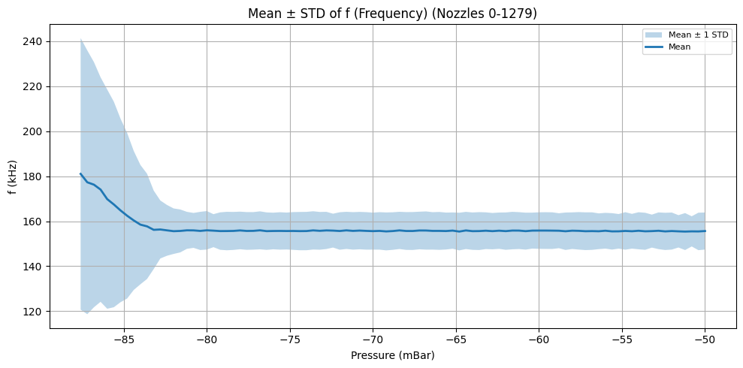

Slide 10
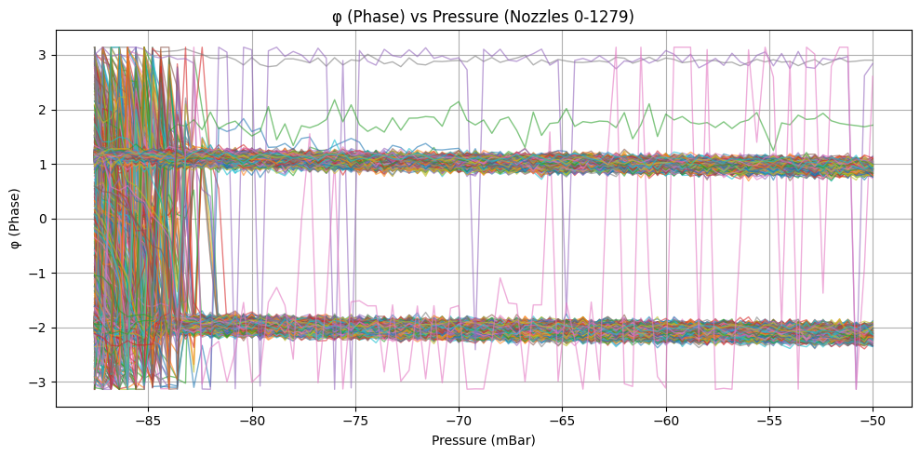

Slide 11
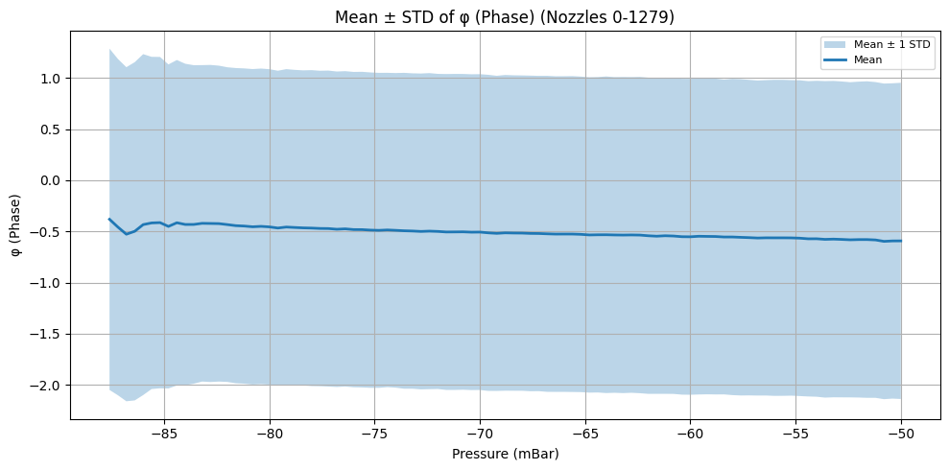

Slide 12
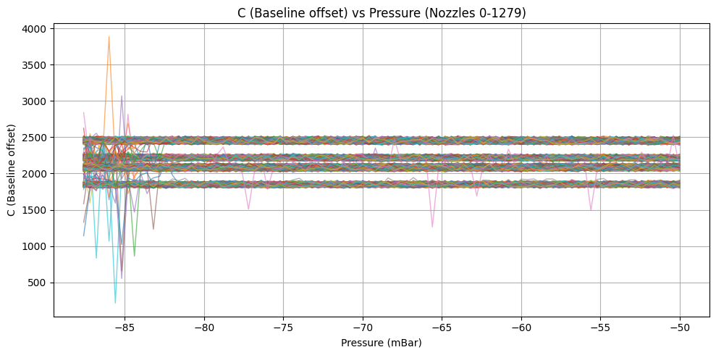

Slide 13
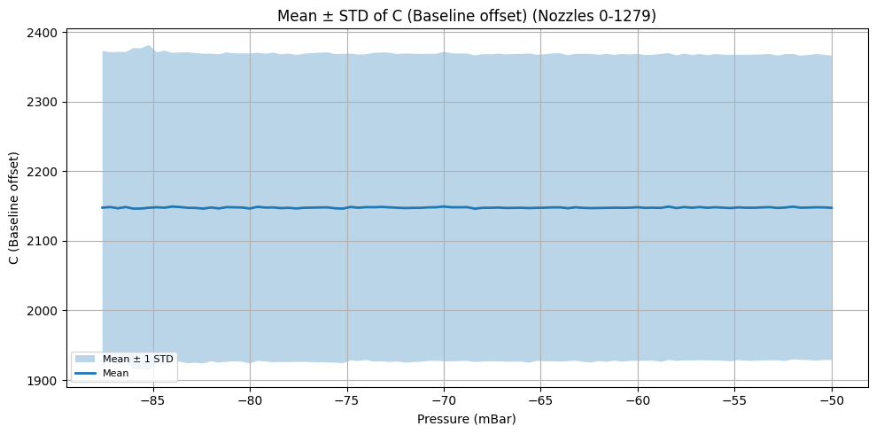

Slide 14
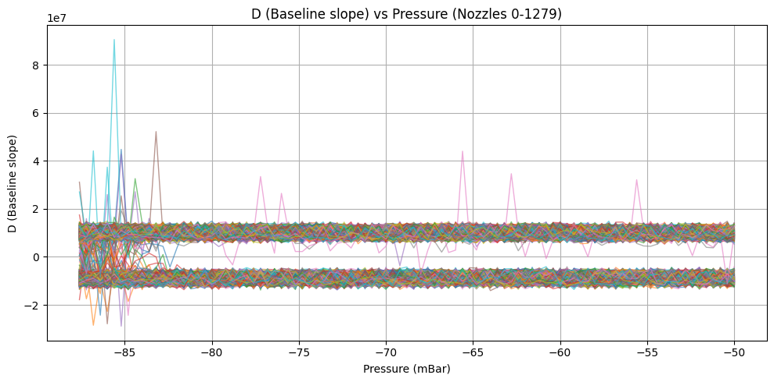

Slide 15
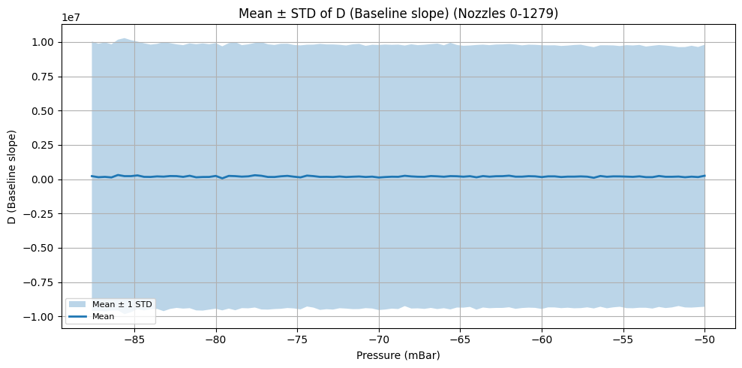

Slide 16
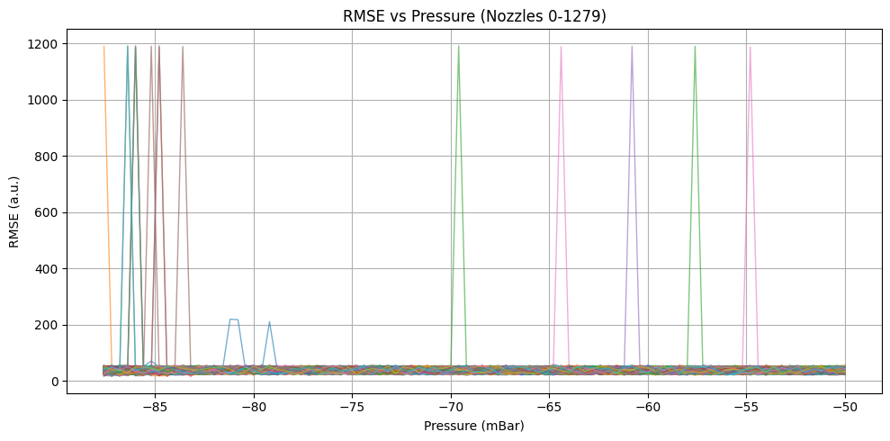

Slide 17
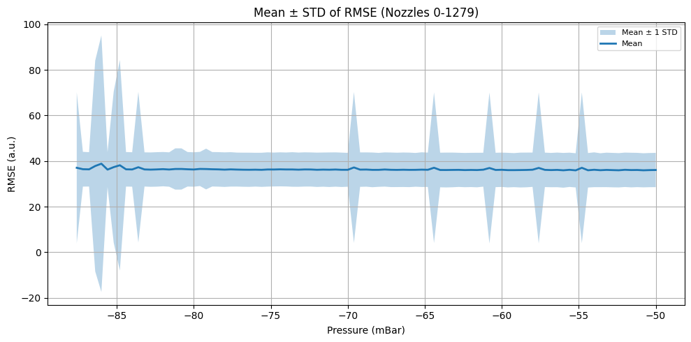

Slide 18
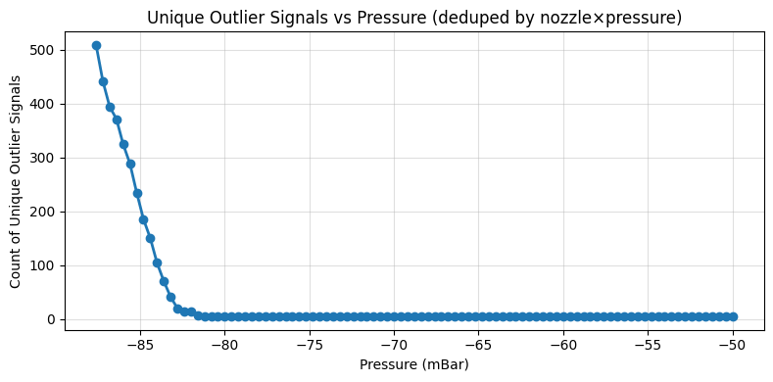
3. Outliers
Unique nozzles flagged: 508/1280 (39.69%)
Unique (nozzle × pressure) signals flagged: 3557/121600 (2.93%)

Slide 19
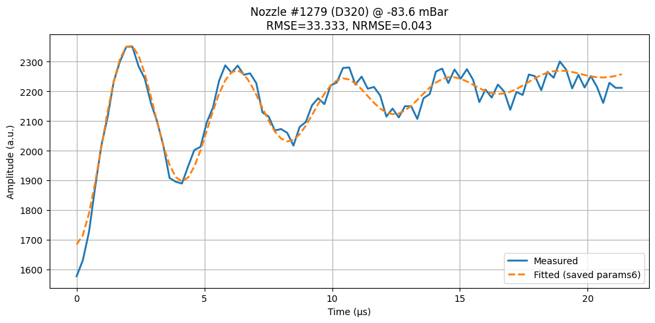
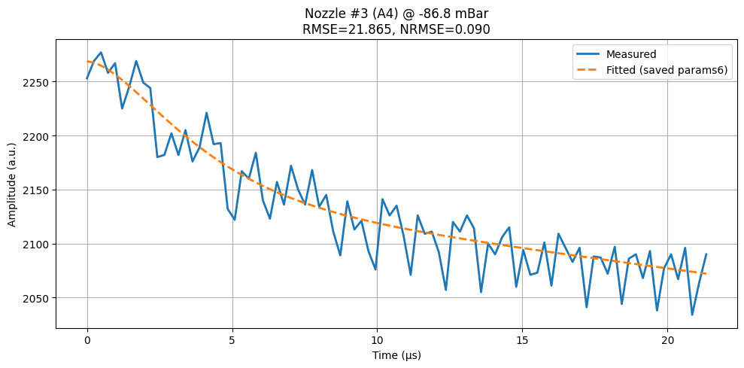
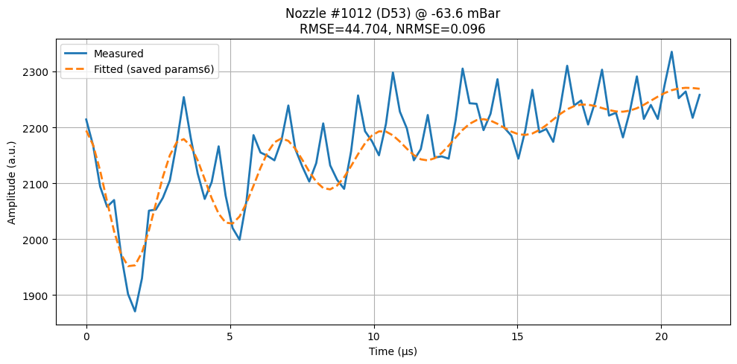

Slide 20
4.Parameters and pressure correlation
Inputs : 6 parameters (A, τ, f, φ, C, D)
GroupShuffleSplit (80/20) by nozzle:
1,024 nozzles for training,
256 nozzles for testing.

Slide 21
Models
Ridge Regression (linear baseline)
  With median imputation + robust scaling
  Hyperparameter tuned: regularization strength (α)
HistGradientBoostingRegressor (HGB, nonlinear tree-based)
  Automatically handles nonlinearities and interactions
  Hyperparameters tuned via random search:
    learning rate, max depth, leaf size, L2 regularization.
Both were tuned using grouped cross-validation (GroupKFold) on a subset of training nozzles.

Slide 22
Evaluation
Metric | Meaning
MAE | Mean absolute error (mBar)
RMSE | Root mean squared error (mBar)
R² | Proportion of variance explained
Model | R² | MAE (mBar) | RMSE (mBar)
Ridge | 0.02 | 9.35 | 10.85
HGB | 0.53 | 5.91 | 7.51
HGB explains 53% of the variance in pressure

Slide 23
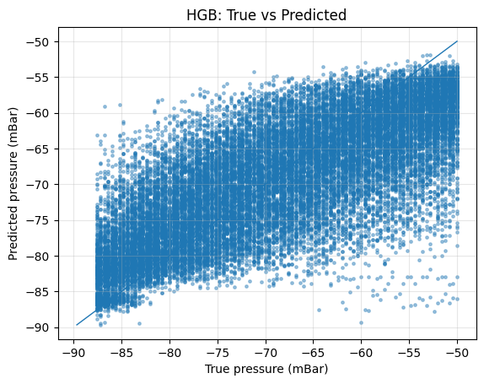
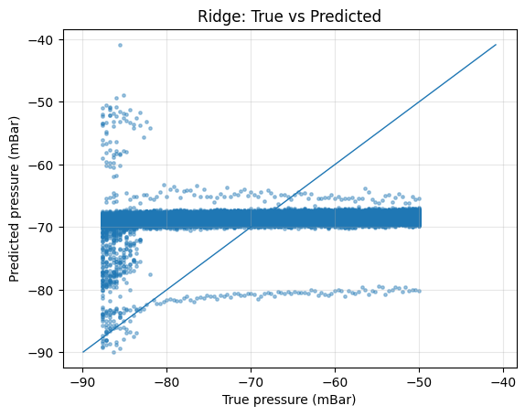
Plots

Slide 24
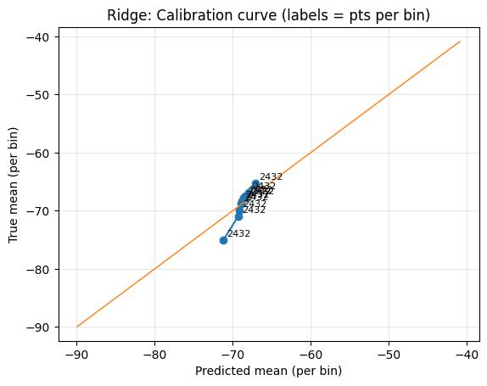
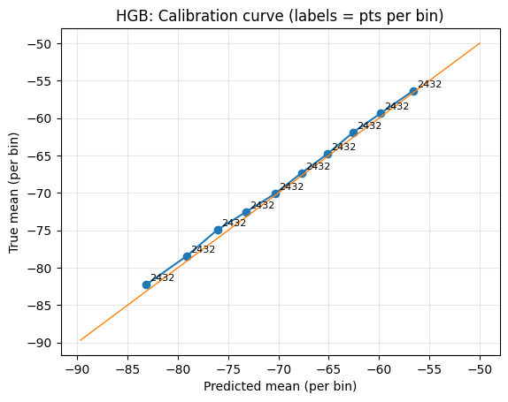

Slide 25
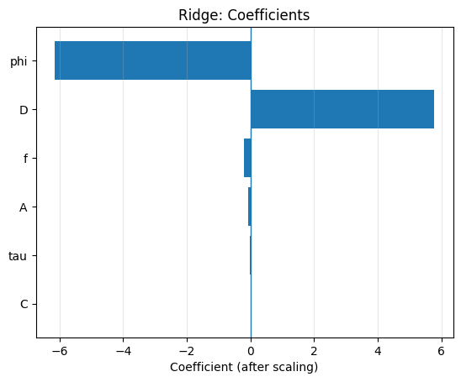
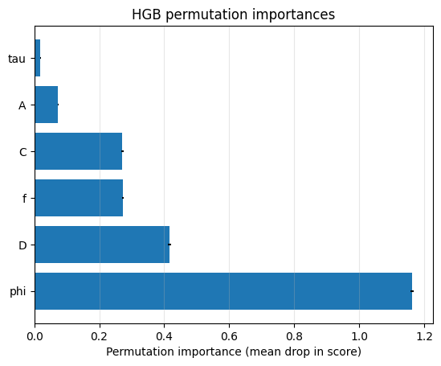

Slide 26
Observations
Ridge:
Predictions almost flat around −70 mBar → no linear trend.
Confirms little to no linear correlation.
HGB:
Predictions follow the true pressure trend much better.
Calibration curve lies almost perfectly on the 1:1 line → well-calibrated model.

Slide 27
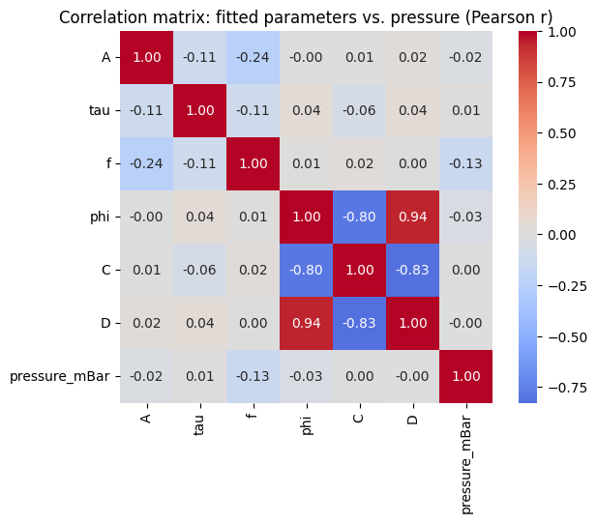
Correlation matrix

Slide 28
Correlation matrix interpretation
Pearson correlation matrix showed:
  Very weak direct correlation between each feature and pressure (|r| < 0.15)
  Strong internal correlations among φ, C, and D (|r| ≈ 0.8–0.9)
This explains why the linear model failed: no simple linear mapping exists.
HGB succeeded because it can model nonlinear interactions between correlated variables.

